Slide 1
QR CODE
SUBMITTED BY:
DEEPIKA RANI. A
MAHIMA CHOWDARY. K
NANDINI. B
SWATHI. A
SUBMITTED TO:
DURGA DEVI. K
ASST PROFESSIOR

Slide 2
ABSTRACT
Educational institution in developing countries is a vast sector and it is expanding rapidly. With the rapid growth of technologies, educational institutions are still lagging behind. For identification of students they still lie on manual handwritten ID card and files. If proper ID card system is introduced then it would be much easier to identify a student and can track his/her progress.
QR(Quick Response )Code is a two dimensional bar code readable by QR scanners.QR code is a capable of storing several hundred times more information than a barcode. QR code system is used in combination with a QR code printer and QR code scanner.
Automated student ID had image capturing facility and requirements of an ID and there is no need of hand written ID card and printed card. QR code is attached into ID card and student personal details can be found by scanning the QR code with smart phones (downloaded & installed QR reader software). QR code is said to be the next generation of bar code and using QR code with ID card brought positive outcomes.

Slide 3
BASE STUDY
A QR Code is a two-dimensional barcode that is readable by smartphones. It allows to encode over 4000 characters in a two dimensional barcode. QR code is a block of smaller black and white squares is read by a smart phone's image sensor, then interpreted by the system processor.
The three large squares act as alignment targets, while the smaller square in the remaining corner acts to normalize the size and angle of the shot. As you can see from the image on the left, the blue strips near the alignment squares contain formatting information.
The remaining yellow area is the actual data that's converted into binary code and checked for errors before being displayed. The encoded data can be interpreted as one of four primary modes—numeric, alphanumeric, byte/binary. Other forms of data can also be displayed with the appropriate extensions.

Slide 4
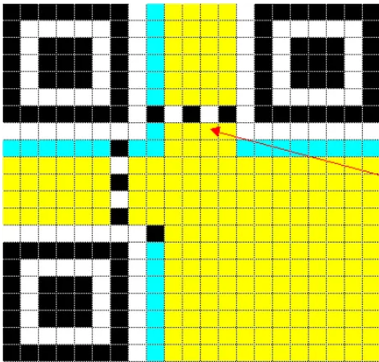
Sample QR code

Slide 5
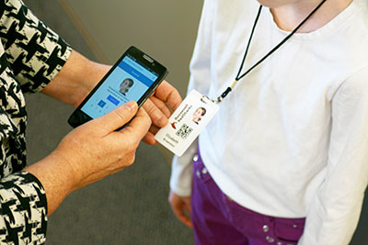
QR codes are often square-shaped, displaying their data vertically or horizontally. QR codes can hold hundreds of times more encrypted characters than a barcode.
If a person sees a QR code somewhere, they can take out their mobile device, download a free QR code scanning app, and "scan" the QR code to get a details of particular person.

Slide 6
EXISTING SYSTEM
The ID is also known as the portion of identification or the paper of any person. It is a small standard size card and usually called the identity card that can be easily kept in a pocket or inside wallet.
A card can show data of the identification about any person including names (first name, surname, last name), age, address.These types identification are used commonly in place of school or collage for the student, companies for the employees. Therefore it can be said that student ID card is the card of identification which is used for holding specific characteristic of students.

Slide 7
PROPOSED SYSTEM
A student ID card generally deals with the fields:
Students Name, Class Roll Number, Registration, Number, Session, Name of the department, Hall name.
To demonstrate the administrative requirements we need to meet the administration the following parameters:
Basic student information, The feature, Add / remove department name and hall name, Find student information using unique ID number.
As we can compare traditional ID of any developing country then it will only contain all the details with hand written, printed card and anyone can make the fake ID card easily. When administrator make ID card with his or her hand writing then it can be filled of error and mistake. Sometimes they made the mistake of writing wrong name with spelling and
so on.

Slide 8
THANK YOU

